Slide 1
mongo1
mongo2
mongo1
mongo2
mongo1
mongo2
mongo3
mongo-client
mongo3
mongo-client
mongo3
mongo-client
Host : Docker engine
Host : Docker engine
Host : Docker engine
Docker Swarm
Host OS

Slide 2
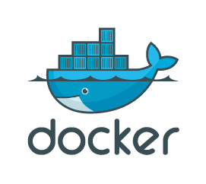
Docker
Port : 5000
registry
Manager
(dind)
worker01
(dind)
worker02
(dind)
worker03
(dind)
/var/lib/registry
/stack
Volume mount
Host OS(Windows)
Registry-data
Port : 5000
./stack

